Slide 1


Galgotias College of Engineering and Technology, Greater Noida
Natural Numbers, Recurrence Relation and Combinatorics
UNIT-5
Discrete Mathematics
Aditya Narayan Singh
Assistant Professor
Department of MCA
MCA
Ist Sem

Slide 2
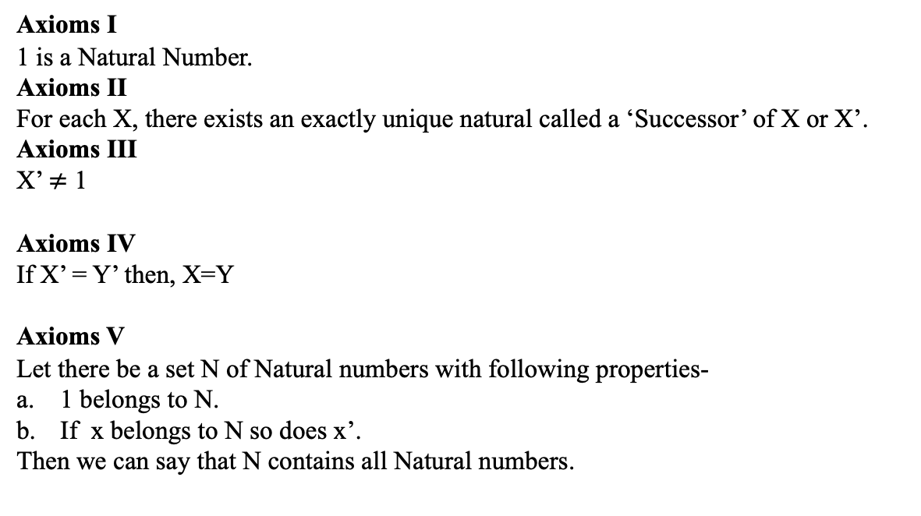
Peano Axioms (CO5)
Axioms I
1 is a Natural Number.
Axioms II
For each X, there exists an exactly unique natural called a ‘Successor’ of X or X’.
Axioms III
X’ $≠$ 1
Axioms IV
If X’ = Y’ then, X=Y
Axioms V
Let there be a set N of Natural numbers with following properties-
1 belongs to N.
If x belongs to N so does x’.
Then we can say that N contains all Natural numbers.

Slide 3
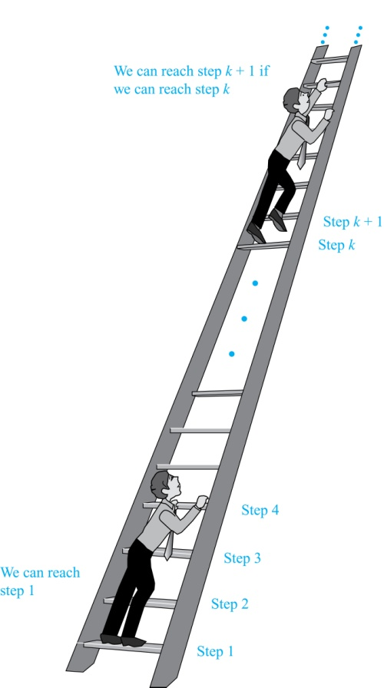
Principle of Mathematical Induction (CO5)
Discrete mathematics is more concerned with number systems such as the integers, whole numbers, etc...
Mathematical Induction is a mathematical technique which is used to prove a statement, a formula or a theorem is true for every natural number.
Suppose we have an infinite ladder:
We can reach the first rung of the ladder.
If we can reach a particular rung of the ladder, then we can reach the next rung.
Can we reach every step on the ladder?

Slide 4
Principle of Mathematical Induction (CO5)
Principle of Mathematical Induction: To prove that P(n) is true for all positive integers n, we complete these steps:
Basis Step: Show that P(1) is true.
Inductive Step: Show that P(k) → P(k + 1) is true for all positive integers k.
To complete the inductive step, assuming the inductive hypothesis that P(k) holds for an arbitrary integer k, show that must P(k + 1) be true.
Climbing an Infinite Ladder Example:
BASIS STEP: By (1), we can reach rung 1.
INDUCTIVE STEP: Assume the inductive hypothesis that we can reach rung k. Then by (2), we can reach rung k + 1.
Hence, P(k) → P(k + 1) is true for all positive integers k. We can reach every rung on the ladder.

Slide 5
Principle of Mathematical Induction (CO5)
Mathematical induction can be expressed as the rule of inference
(P(1) ∧ ∀k (P(k) → P(k + 1))) → ∀n P(n),
where the domain is the set of positive integers.
In a proof by mathematical induction, we don’t assume that P(k) is true for all positive integers! We show that if we assume that P(k) is true, then P(k + 1) must also be true.
Proofs by mathematical induction do not always start at the integer 1. In such a case, the basis step begins at a starting point b where b is an integer.
Mathematical induction is valid because of the well ordering property

Slide 6
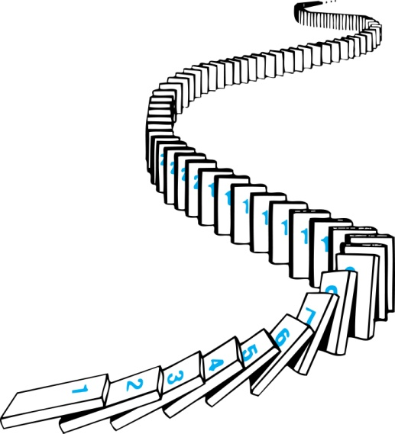
How Mathematical Induction Works (CO5)
Consider an infinite sequence of dominoes, labeled 1,2,3, …, where each domino is standing.
Let P(n) be the proposition that the n^{th} domino is knocked over.
know that the first domino is knocked down, i.e., P(1) is true.
We also know that if whenever the k^{th} domino is knocked over, it knocks over the (k + 1)^{st} domino, i.e, P(k) → P(k + 1) is true for all positive integers k.
Hence, all dominos are knocked over.
P(n) is true for all positive integers n.

Slide 7
Examples of mathematical induction (CO5)
Example 1: Show that: For every positive integer n,
1 + 2 +···+ n = n(n + 1)/ 2
Solution:
BASIS STEP: P(1) is true since 1(1 + 1)/2 = 1.
INDUCTIVE STEP: Assume true for P(k).
1 + 2 +···+ k = k(k + 1)/ 2 ---- (i) (inductive hypothesis)
Our goal is to show that:
1 + 2 +···+ k + (k + 1) = [k + 1]([k + 1] + 1)/ 2 i.e. 1 + 2 +···+ k + (k + 1) = (k + 1)(k + 2) /2
Add k + 1 both sides to equation (i), we get,
1 + 2 +···+ k + (k + 1) = k(k + 1)/ 2 + (k + 1) = k(k + 1) /2 + 2(k + 1) /2 = (k + 2)(k + 1) /2
Hence, we have shown that P(k + 1) follows from P(k).
Therefore the sum of the first n positive integers is n(n + 1)/ 2 .

Slide 8
Examples of mathematical induction (CO5)
Example 2: Using the principle of mathematical induction, prove that 7^{2n} + 2^{3n-3}. 3^{n-1} is divisible by 25 for all n ∈ N.
Solution:
BASIS STEP: P(1)
INDUCTIVE STEP: Assume true for P(k).

Slide 9
Mathematical induction (CO5)
Non-zero base case
We may relax the requirement for the Base case to start from 0, to let it start from any a ∈ Z.
The Induction rule becomes:
P(a) ∀ integers k≥a, P(k)→P(k+1)
•∀ integers n≥a, P(n)
Note that the conclusion says P(n) is true for n ≥ a, and is silent about P(n) for n < a.

Slide 10
Strong Induction (CO5)
The difference between Strong Induction and Regular Induction lies only in the Inductive hypothesis. All other steps remain unchanged.
In the Inductive hypothesis in Regular Induction, you assume P(k) is true. In Strong Induction, you assume P(k),P(k −1),P(k −2),...,P(a) are all true.
That is, you make a stronger assumption about the values of n which make P(n) true, hence the name Strong Induction. From this stronger assumption, you proceed as before to show that P(k + 1) is true.
It may be shown that Regular Induction implies Strong Induction and vice versa. That is, anything that can be proven using Regular Induction can be proven using Strong Induction, and vice versa. However, the benefit of using Strong Induction is the convenience of using more assumptions. The next example illustrates this.

Slide 11
Strong Induction (CO5)
Prove: ∀ integers n > 1, n has a prime factorization.
1. Let P(n) = (n has a prime factorization), for any integer n > 1.
2. Base case: n = 2 3. Since 2 is prime, 2 = 2 is a trivial prime factorization.
4. Thus P(2) is true.
5. Inductive step: For any integer k > 1: 6. Assume P(i) is true for 1 < i ≤ k. (Stronger assumption)
7. That is, all integers i in the range 1 < i ≤ k have prime factorizations.
8. Consider the integer k + 1:
9. If k +1 is prime:
10. Then k + 1 = k + 1 is a trivial prime factorization, and P(k + 1) is true.

Slide 12
Strong Induction (CO5)
Else k + 1 is composite:
Thenk+1=rs,for some integers r,s such that
1 < r , s < k + 1, by definition of composite.
Then both r and s have prime factorizations,
by the Inductive hypothesis.
Let these be r = p1p2 ...pu and s = q1q2 ...qv, where all the factors are prime.
Then k+1= rs =p1p2...puq1q2...qv,by basic algebra.
Thus k + 1 has a prime factorization, and P(k + 1) is true.
So by Strong Induction, the statement is true.

Slide 13
Objectives of Topic: Recurrence Relation(CO5)
Implementation of recursive techniques that can derive sequences and be useful for solving counting problems.

Slide 14
Prerequisite and recap: Recurrence Relation(CO5)
Prerequisite
Counting problems.
Recap
Problem solving using series and combination.

Slide 15
Recurrence Relation(CO5)
A sequence is a discrete structure used to represent an ordered list. For example, 1, 2, 3, 5, 8 is a sequence with five terms and 1, 3, 9, 27, 81 , … , 3n, … is an infinite sequence.
A sequence is a function from a subset of the set of integers (usually either the set {0, 1, 2, …} or the set {1, 2, 3, …}) to a set S. We use the notation an to denote the image of the integer n.
The way to specify a sequence is to provide one or more initial terms together with a rule for determining subsequent terms from those that precede them.
A recurrence relation for the sequence {an} is an equation that expresses an in terms of one or more of the previous terms of the sequence, namely, a0, a1, … , an−1, for all integers n with n ≥ n0, where n0 is a nonnegative integer.
A sequence is called a solution of a recurrence relation if its terms satisfy the recurrence relation. (A recurrence relation is said to recursively define a sequence.

Slide 16
Recurrence Relation(CO5)
A recurrence relation is a functional relation between the independent variable x, dependent variable f(x) and the differences of various order of f (x). A recurrence relation is also called a difference equation, and we will use these two terms interchangeably.
Example1: The equation f (x + 3h) + 3f (x + 2h) + 6f (x + h) + 9f (x) = 0 is a recurrence relation.
It can also be written as a_{r+3} + 3a_{r+2} + 6a_{r+1} + 9a_{r} = 0
A recurrence relation is an equation that recursively defines a sequence where the next term is a function of the previous terms. First few term are called initial condition of recurrence relation
Example 1 Fibonacci series F_{n} = F_{n−1}+ F_{n−2}
Example 2 a_{n} = a_{n−1}+ 2 with a₀ = 1

Slide 17
Order & Degree of Recurrence Relation(CO5)
Order of the Recurrence Relation:
The order of the recurrence relation or difference equation is defined to be the difference between the highest and lowest subscripts of f(x).
Example1: The equation 13a_{r}+20a_{r-1}=0 is a first order recurrence relation.
Example2: The equation 8f (x) + 4f (x + 1) + 8f (x+2) = k (x)
Degree of the Difference Equation:
The degree of a difference equation is defined to be the highest power of f (x) or a_{r}=y_{k}
Example1: The equation y³_{k+3}+2y²_{k+2}+2y_{k+1}=0 has the degree 3, as the highest power of y_{k} is 3.
Example2: The equation a⁴_{r}+3a³_{r-1}+6a²_{r-2}+4a_{r-3} =0 has the degree 4, as the highest power of a_{r} is 4.
Notes:
For a first order recursion xn+1=f(xn), one just needs to start with an initial value x0 and can generate all remaining terms using the recurrence relation.
For a second order recursion xn+1=f(xn,xn−1), one needs to begin with two values x0 and x1.

Slide 18
Linear Recurrence Relation(CO5)
A linear recurrence equation of degree k or order k is a recurrence equation which is in the format
x_{n} = A₁x_{n−1}+A₂x_{n−2}+A₃x_{n−3}+…..+A_{k}x_{n - k} (A_{n} is a constant and A_{k}≠0) on a sequence of numbers as a first-degree polynomial.
Each term of a sequence is a linear function of earlier terms in the sequence.
For example: a0 = 1 a1 = 6 a2 = 10
an = an−1 + 2 an−2 + 3 an−2
a3 = a0 + 2a1 + 3a2
= 1 + 2(6) + 3(10) = 43

Slide 19
Linear Recurrence Relation Types(CO5)
Linear recurrences has following types:
Linear homogeneous recurrences
Linear non-homogeneous recurrences

Slide 20
Linear homogeneous recurrences(CO5)
A linear homogenous recurrence relation of degree k with constant coefficients is a recurrence relation of the form
an = c1 an-1 + c2 an-2 + … + ck an-k,
where c1, c2, …, ck are real numbers, and ck ≠ 0, an is expressed in terms of the previous k terms of the sequence, so its degree is k. This recurrence includes k initial conditions.
a0 = C0
a1 = C1 ……………………… ak = Ck

Slide 21
Solution of linear Recurrence Relation(CO5)
We can find any solution of the form an = r^{n} that satisfies the recurrence relation.
Recurrence relation are given in that form
an = c1 an-1 + c2 an-2 + …………………. + ckan-k
Put the values an = r^{n} in above recurrence relation
r^{n} = c₁r^{n-1} - c₂r^{n-2} - … - c_{k}r^{n-k}
r^{n} - c₁r^{n-1} - c₂r^{n-2} - … - c_{k}r^{n-k} = 0
dividing both sides by r^{n-k}
r^{k} - c₁r^{k-1} - c₂r^{k-2} - … - c_{k} = 0
This equation is called the characteristic equation

Slide 22
Solution of linear Recurrence Relation(CO5)
Suppose, a two ordered linear recurrence relation is − Fn=AFn−1+BFn−2 where A and B are real numbers.
The characteristic equation for the above recurrence relation is −
X² −Ax−B=0
Three cases may occur while finding the roots −
Case 1 − If this equation factors as (x−x1)(x−x2)=0and it produces two distinct real roots x1 and x2, then Fn=ax1^{n}+bx2^{n} is the solution. [Here, a and b are constants]
Case 2 − If this equation factors as (x−x1)² =0 and it produces single real root x1, then Fn=ax1^{n}+bnx1^{n} is the solution.
Notes:
Case 3 − If the equation produces two distinct complex roots, x1 and x2 in polar form.

Slide 23
Linear Recurrence Relation Example(CO5)
Question1 What is the solution of the recurrence relation
a_{n} = a_{n-1} + 2a_{n-2} with a₀=2 and a₁=7?
Solution: Since it is linear homogeneous recurrence, first find its characteristic equation
a_{n} - a_{n-1} - 2a_{n-2} =0
r² - r - 2 = 0
(r+1)(r-2) = 0
r₁ = 2 and r₂ = -1
So, a_{n} = A2^{n} + B(-1)^{n} is a solution.

Slide 24
Solution of linear Recurrence Relation(CO5)
a_{n} = A2^{n} + B(-1)^{n}
Now we should find A and B using initial conditions.
Put n = 0 and 1 in above equation
a₀ = A + B = 2
a₁ = 2A - B = 7
Solve above these equation A = 3 and B = -1
a_{n} = 3.2^{n} - (-1)^{n} is a solution.

Slide 25
Linear Recurrence Relation Example with initial conditions(CO5)
Question 2 What is the solution of the recurrence relation
a_{n} = 6a_{n-1} - 9a_{n-2} with a₀=1 and a1=6?
Solution: First find its characteristic equation
r² - 6r + 9 = 0
(r - 3)² = 0 r₁ = 3
So, by theorem a_{n} = (A + Bn) (3)^{n} is a solution.
Now we should find constants using initial conditions.
A = 1 and B= 1
a_{n} = 3^{n} + n3^{n} is a solution.

Slide 26
Linear Recurrence Relation Example with initial conditions(CO5)
Question 3 What is the solution of the recurrence relation
a_{n} = -3a_{n-1} - 3a_{n-2} - a_{n-3} with a₀=1, a₁=-2 and a₂=-1?
Solution Find its characteristic equation
r³ + 3r² + 3r + 1 = 0
(r + 1)³ = 0 then r₁= -1
Then an = (A + B n + Cn²)(-1)^{n} is a solution.
Now we should find constants using initial conditions. And find the value of A, B and C
A = 1 B = 3 C = -2
Then put the value of A, B and C in above equation
a_{n} = (1 + 3n - 2n²) (-1)^{n} is a solution.

Slide 27
Linear non-homogeneous recurrences(CO5)
A linear non-homogenous recurrence relation with constant coefficients is a recurrence relation of the form
a_{n} = c₁ a_{n-1} + c₂ a_{n-2} + ………….. + c_{k} a_{n-k}+ f(n)
where c₁, c₂, …….., c_{k} are real numbers, and f(n) is a function depending only on n.
The recurrence relation
a_{n} = c₁ a_{n-1} + c₂ a_{n-2} + ………….. + c_{k} a_{n-k} is called the associated homogeneous recurrence relation.
This recurrence includes k initial conditions.
a₀ = C₀ a₁ = C₁… a_{k} = C_{k}

Slide 28
Linear non-homogeneous recurrences(CO5)
The following recurrence relations are linear non homogeneous
recurrence relations.
Example 1 a_{n} = a_{n-1} + 2^{n}
Example 2 a_{n} = a_{n-1} + a_{n-2} + n² + n + 1
Example 3 a_{n} = a_{n-1} + a_{n-4} + n!
Example 4 a_{n} = a_{n-6} + n2^{n}

Slide 29
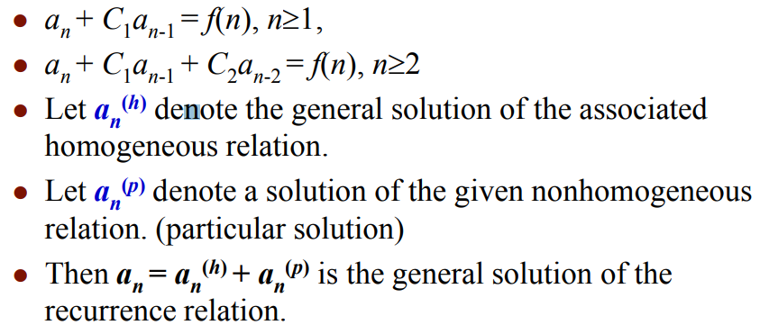
Linear non-homogeneous recurrences(CO5)

Slide 30
Order of Linear Non-Homogeneous Recurrence Relation (CO5)
The equation is said to be linear homogeneous difference equation if and only if R (n) = 0 and it will be of order n.
The equation is said to be linear non-homogeneous difference equation if R (n) ≠ 0.
Example1: The equation a_{r+3}+6a_{r+2}+12a_{r+1}+8a_{r}=0 is a linear non-homogeneous equation of order 3.
Example2: The equation a_{r+2}-4a_{r+1}+4a_{r}= 3r + 2^{r} is a linear non-homogeneous equation of order 2.
A linear homogeneous difference equation with constant coefficients is given by
C₀ y_{n}+C₁ y_{n-1}+C₂ y_{n-2}+⋯......+C_{r} y_{n-r}=0 ....... equation (i)
Where C₀,C₁,C₂.....C_{n} are constants.

Slide 31
Linear non-homogeneous recurrences Example(CO5)
Q1 What is the solution of the recurrence relation
a_{n} = 2a_{n-1} - a_{n-2} + 2^{n} for n>=2,
with a₀=1 and a₁=2?
Solution: The characteristic equation of its associated homogeneous relation is: x² -2x+1 = 0
(x-1)(x-1)=0
x₁ =1 and x₂ =1
a_{h} = (b1 + b2n)x₁^{n}
a_{h} = (b1 + b2n).1^{n}
a_{n} = a_{h} + a_{p}
a_{p =➔. Put} a_{n =} 2^{n} A
2^{n} A ⁼ 2^{n-1} *2* A - 2^{n-2} A + 2^{n}
^{A= 4}
a_{p} ⁼ 2^{n} A = 2^{n} .4
a_{n} = a_{h} + a_{p}
a_{n =} (b1 + b2n).1^{n} +2^{n} .4 ---(i)
a₀=1 and a₁=2
b1 = -3
b2 = -3
Put b1 and b2 value in eq -----(i)

Slide 32
Linear non-homogeneous recurrences Example(CO5)
Q2 What is the solution of the recurrence relation
a_{n} = 2a_{n-1} - a_{n-2} + n.2^{n} for n>=2,
with a₀=1 and a₁=2?
Solution: The characteristic equation of its associated homogeneous relation is: x² -2x+1 = 0
(x-1)(x-1)=0
x₁ =1 and x₂ =1
a_{h} = (b1 + b2n)x₁^{n}
a_{h} = (b1 + b2n).1^{n}
a_{n} = a_{h} + a_{p}
a_{p =➔. Put} a_{n =} 2^{n} (A + B.n)
2^{n} (A + B.n) – 2* 2^{n-1} (A + B.{n-1}) + 2^{n-2} (A + B.{n-2}) = 2^{n}

Slide 33
Linear non-homogeneous recurrences Example(CO5)
(A/2 – 5/2*B ) + ½ * B*n = n
Comparing coefficient of both side
B = 2, A = 10
a_{n} = a_{h} + a_{p}
a_{n =} (b1 + b2n).1^{n} +2^{n} (A + B.n)
a_{n =} (b1 + b2n).1^{n} +2^{n} (10 + 2*n) -----(i)
a₀=1 and a₁=2
b1 = -9
b2 = -13
Put b1 and b2 value in eq -----(i)

Slide 34
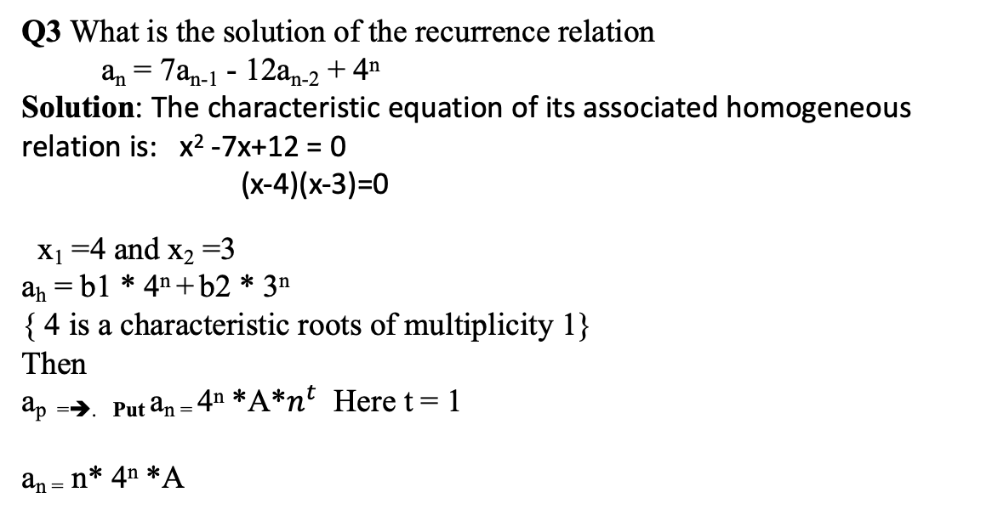
Linear non-homogeneous recurrences Example(CO5)
Q3 What is the solution of the recurrence relation
a_{n} = 7a_{n-1} - 12a_{n-2} + 4^{n}
Solution: The characteristic equation of its associated homogeneous relation is: x² -7x+12 = 0
(x-4)(x-3)=0
x₁ =4 and x₂ =3
a_{h} = b1 * 4^{n} + b2 * 3^{n}
{ 4 is a characteristic roots of multiplicity 1}
Then
a_{p =➔. Put} a_{n =} 4^{n} *A*$n^{t}$ Here t = 1
a_{n =} n* 4^{n} *A

Slide 35
Topic objective: Generating function (CO5)
It will be useful in solving recurrence relations.
proving some of the combinatorial identities.
It will help finding asymptotic formulae for terms of sequences.

Slide 36
Prerequisite and recap: Generating function (CO5)
Prerequisite
Recurrence relation and functions.
Recap
Use of recurrence relation to solve variety of counting problems.

Slide 37
Generating Function(CO5)
Generating function is a method to solve the recurrence relations.
Let us consider, the sequence a₀, a₁, a₂....a_{r} of real numbers. For some interval of real numbers containing zero values at t is given, the function G(t) is defined by the series G(t)= a₀+ a₁t+a₂ t²+⋯+a_{r} t_{r}+............equation (i)
This function G(t) is called the generating function of the sequence a_{r}.

Slide 38
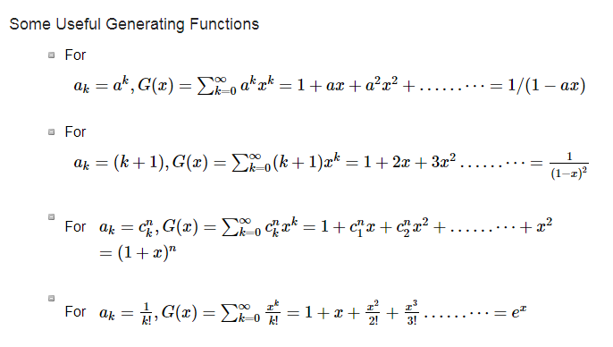
Generating Function(CO5)

Slide 39
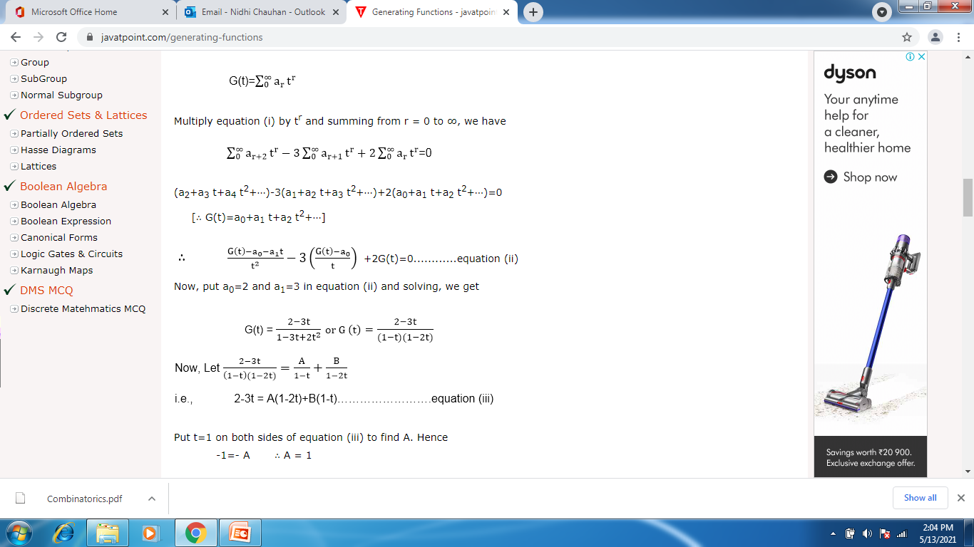
Generating Function example(CO5)
Example: Solve the recurrence relation a_{r+2}-3a_{r+1}+2a_{r}=0.By the method of generating functions with the initial conditions a₀=2 and a₁=3.
Solution: Let us assume that

Slide 40
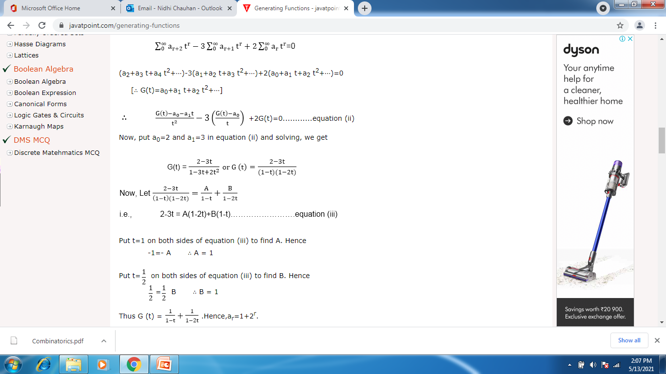
Generating Function(CO5)

Slide 41
Topic Objective: Combinatorics (CO5)
The student will be able to:
perform counting of specified structures, sometimes referred to as arrangements or configurations in a very general sense, associated with finite systems.
find the "best" structure or solution among several possibilities, be it the "largest", "smallest" or satisfying some other optimality criterion.

Slide 42
Topic Prerequisite & Recap
Prerequisite
Basic Understanding of Probability and Combination.
Counting Principles of sum and product rule.
Recap
The concepts of set, relation and function.

Slide 43
Combinatorics (CO5)
Combinatorics: also called combinatorial mathematics, the field of mathematics concerned with problems of selection, arrangement, and operation within a finite or discrete system. Included is the closely related area of combinatorial geometry
Combinatorics is an area of mathematics primarily concerned with counting, both as a means and an end in obtaining results, and certain properties of finite structures.
It is closely related to many other areas of mathematics and has many applications ranging from logic to statistical physics, from evolutionary biology to computer science, etc

Slide 44
Basic Counting Techniques (CO5)
Sum Rule Principle: Assume some event E can occur in m ways and a second event F can occur in n ways, and suppose both events cannot occur simultaneously. Then E or F can occur in m + n ways.
In general, if there are n events and no two events occurs in same time then the event can occur in n₁+n₂..........n ways.
Example: If 8 male professor and 5 female professor teaching DMS then the student can choose professor in 8+5=13 ways.
Product Rule Principle: Suppose there is an event E which can occur in m ways and, independent of this event, there is a second event F which can occur in n ways. Then combinations of E and F can occur in mn ways.
In general, if there are n events occurring independently then all events can occur in the order indicated as n₁ x n₂ x n₃.........n ways.
Example: In class, there are 4 boys and 10 girls if a boy and a girl have to be chosen for the class monitor, the students can choose class monitor in 4 x 10 = 40 ways.

Slide 45
Basic Counting Techniques (CO5)
Composition table(CO5)
Factorial Function: The product of the first n natural number is called factorial n. It is denoted by n!, read "n Factorial."
The Factorial n can also be written as
n! = n (n-1) (n-2) (n-3)......1.
0! = 1.
Example: Find the value of 5!
Solution:
5! = 5 x (5-1) (5-2) (5-3) (5-4) = 5 x 4 x 3 x 2 x 1 = 120

Slide 46
Permutation(CO5)
Algebraic structures(CO5)
Any arrangement of a set of n objects in a given order is called Permutation of Object. Any arrangement of any r ≤ n of these objects in a given order is called an r-permutation or a permutation of n object taken r at a time.
It is denoted by P (n, r)
P(n,r)=n!/(n−r)!
Permutation relates to the act of arranging all the members of a set into some sequence or order.
If the set is already ordered, then the rearranging of its elements is called the process of permuting.
Permutations occur, in more or less prominent ways, in almost every area of mathematics. They often arise when different orderings on certain finite sets are considered
The example of permutations is the number of 2 letter words which can be formed by using the letters in a word say, GREAT; 5P_2 = 5!/(5-2)!

Slide 47
Combination(CO5)
Monoid Example(CO5)
The combination is a way of selecting items from a collection, such that (unlike permutations) the order of selection does not matter.
In smaller cases, it is possible to count the number of combinations.
Combination refers to the combination of n things taken k at a time without repetition. To refer to combinations in which repetition is allowed, the terms k-selection or k-combination with repetition are often used.
The formula for combinations is: nCr = n!/[r! (n-r)!]
The example of combinations is in how many combinations we can write the words using the vowels of word GREAT; 5C_2 =5!/[2! (5-2)!]

Slide 48
Pigeonhole Principle(CO5)
Pigeonhole principle is one of the simplest but most useful ideas in mathematics.
Type of counting argument, can be used to demonstrate possibly unexpected results.
The most straightforward application is to finite sets (such as pigeons and boxes), it is also used with infinite sets that cannot be put into one-to-one correspondence.

Slide 49
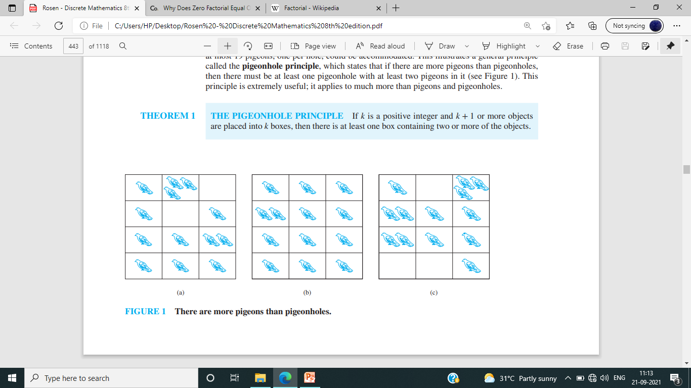
Pigeonhole Principle(CO5)
THE PIGEONHOLE PRINCIPLE If k is a positive integer and k + 1 or more objects are placed into k boxes, then there is at least one box containing two or more of the objects.
Pigeonhole principle states that if there are more pigeons than pigeonholes, then there must be at least one pigeonhole with at least two pigeons in it.
The pigeonhole principle is also called the Dirichlet drawer principle.
THE GENERALIZED PIGEONHOLE PRINCIPLE If N objects are placed into k boxes, then there is at least one box containing at least ⌈N∕k⌉ objects.

Slide 50
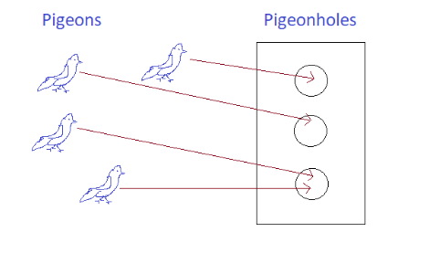
Pigeonhole Principle(CO5)
The Pigeonhole Principle says that if you have more pigeons than pigeonholes, then at least one pigeonhole will get two pigeons.
If you have a function from a finite set to a smaller finite set, then the function cannot be one-to-one; in other words, there must be at least two elements in the domain with the same image in the codomain.
Theorem :Pigeonhole Principle
If f:X→Y .where X and Y are finite sets with |X|>|Y|, then f is not one-to-one.

Slide 51
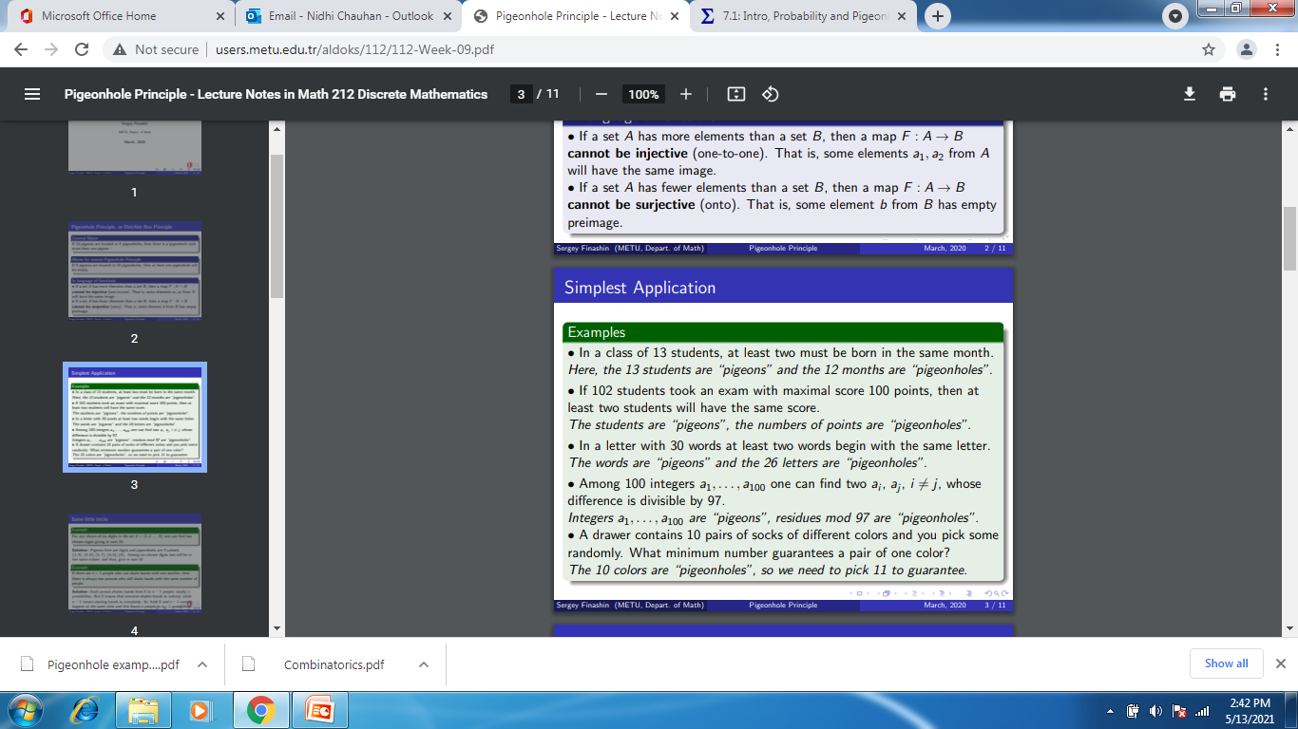
Pigeonhole Principle Problem(CO5)

Slide 52
Thank You

